Slide 1




Checking understanding of pictograms and bar charts
Task A: Pictograms
Complete the statements regarding the pictogram.
Cricket
Most people play football
Golf
Golf is the least played sport
Rugby
Football
Twice as many people play hockey than rugby
Hockey
The same amount of people play football as hockey and rugby combined.
Complete the pictogram.
Jun has 6 more cogs than Izzy.
Jun
Izzy
= 3 cogs
Add the key to this pictogram.
There is a total of 280 apples.
Key
Week 1
=
20 apples
Week 2
Week 3

Slide 2
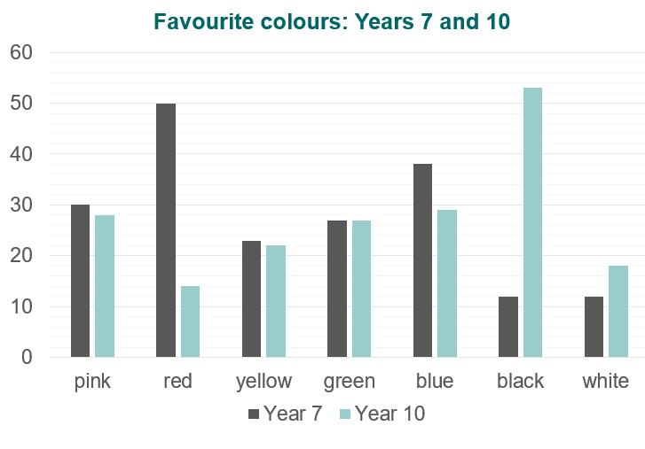
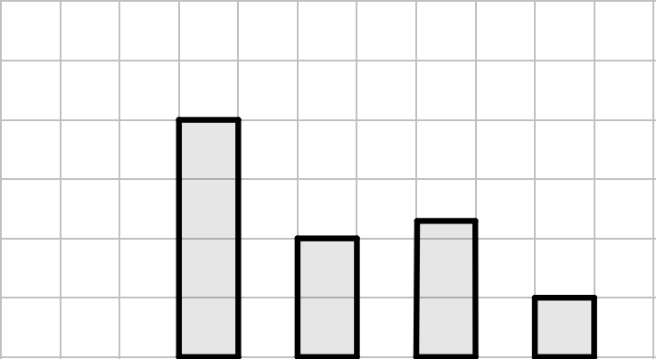
Checking understanding of pictograms and bar charts
Task B: Bar charts
1)
Use this bar chart to answer the following questions:
Which was the most popular colour in each year? Year 7: red, Year 10: black
Compare the number of students who liked yellow best in each year group. One more student liked yellow in year 7 than year 10.
How many more Year 7 students than year 10 students liked green best?
None, it was equal.
How many students were in each year group? Year 7: 192 students Year 10: 191 students
This bar chart shows the different ways that students travel to school. Label the two axes and complete the bar chart based on the clues.
The most popular way to travel is walking.
The least common way to travel is on a scooter.
Twice as many people walk as cycle.
The number of people who travel by car is three-quarters of the number of people who walk.
Twelve people travel by bus.
Frequency
25
20
15
10
5
Car
Walk
Bus
Cycle
Scooter
Methods of travel
Mathematics in Education and Industry.
v2.2

